Slide 1

CROP PRODUCTION ANALYSIS

Slide 2
Introduction
The agriculture sector in India stands at a critical juncture, poised for significant evolution driven by technological advancements and innovative approaches.
This presentation aims to explore the transformative journey of the agriculture business domain in India, with a focus on harnessing the power of the Future Internet and predictive analytics.
Agriculture is the backbone of the Indian economy, employing a significant portion of the population and contributing substantially to the GDP.
With a growing population and increasing demand for food security, the need for sustainable agricultural practices and efficient supply chain management has never been more crucial.

Slide 3
Details of Data
The dataset provides comprehensive information on crop production in India, encompassing various parameters such as state, district, crop year, season, crop type, area under cultivation, and production output.
This rich dataset offers valuable insights into the dynamics of agricultural activities across different regions and seasons, enabling stakeholders to make informed decisions and optimize farming practices.
State Name: Indicates the name of the state where the agricultural activity is recorded.
District Name: Specifies the name of the district within the state where the crop production data is collected.
Crop Year: Represents the year in which the crop was cultivated.
Season: Refers to the specific season during which the crop was grown (e.g., Kharif, Rabi).
Crop: Identifies the type of crop cultivated in the given area.
Area: Denotes the land area (in hectares) under cultivation for the specified crop.
Production: Indicates the total production output (in metric tonnes) of the crop in the given area.

Slide 4
Main KPIs
Total Production:
Definition: Sum of the production output of a specific crop across all areas and districts within a given time frame.
Significance: Indicates the overall productivity and output of the crop.
Total Production Area:
Definition: Sum of the land area under cultivation for a specific crop across all areas and districts within a given time frame.
Significance: Reflects the utilization of agricultural land resources and the extent of cultivation for the crop.

Slide 5
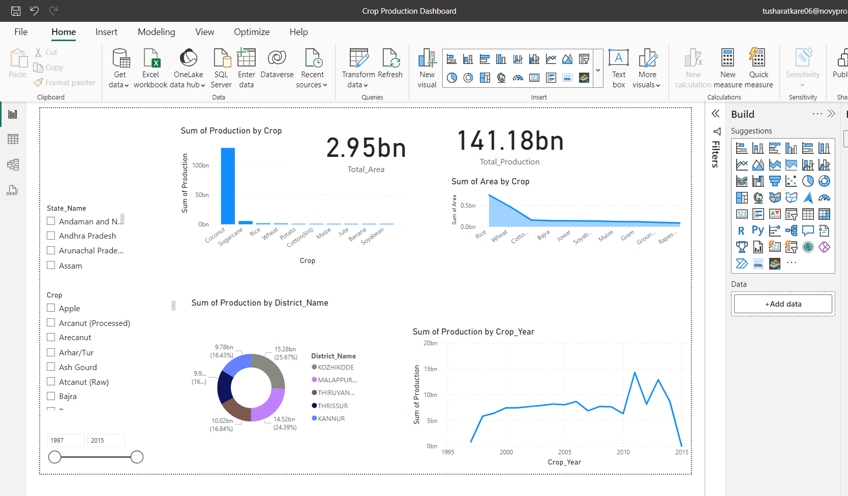
Mock – up Dashboard

Slide 6
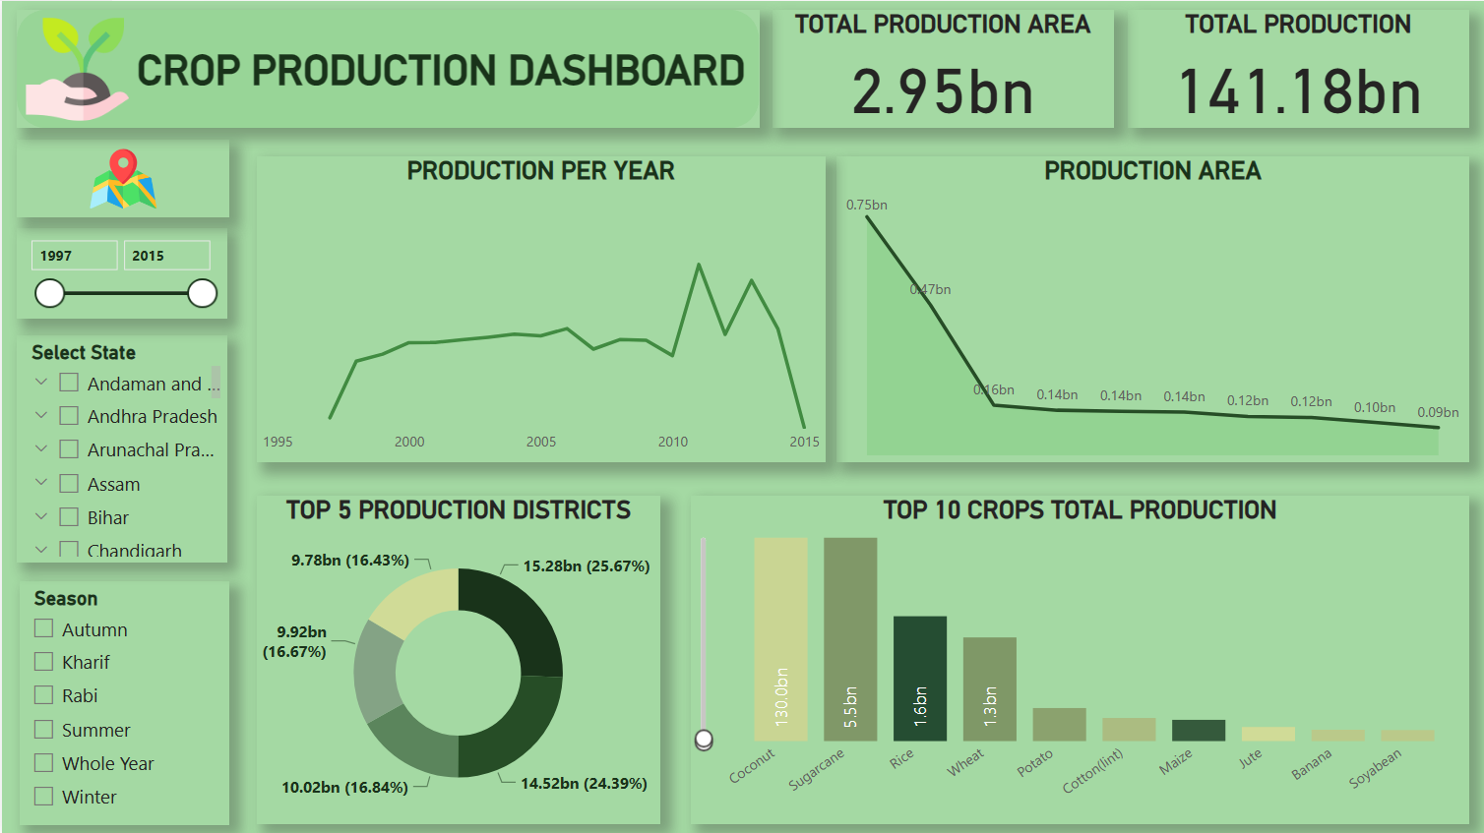
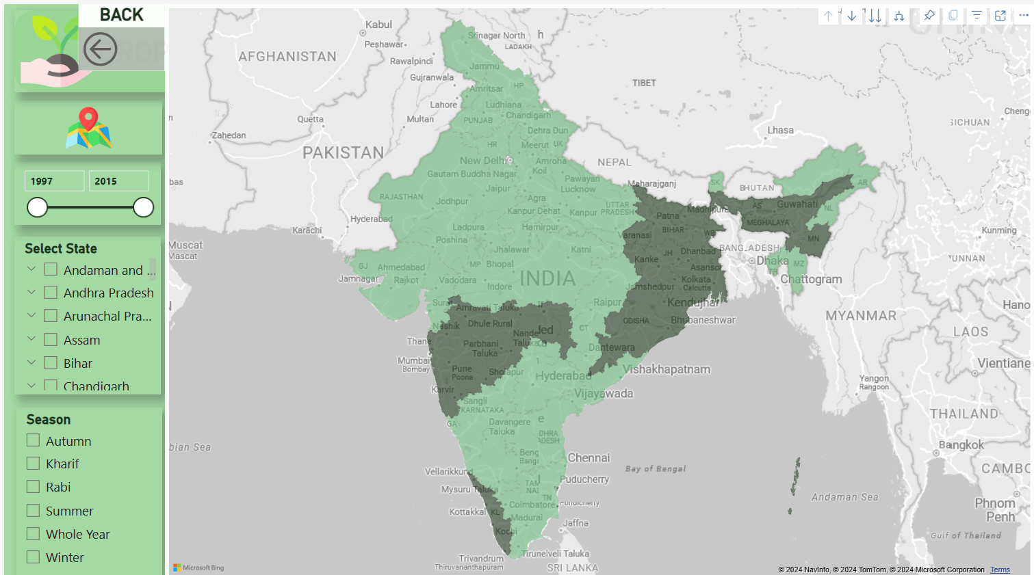
My Design

Slide 7
Thank you

